Slide 1

Smart Home System

Slide 2
Group members
Suhas S 20ETCS002137
Vishnu M V 20ETCS002154
Danesh S D 20ETCS002041
Badri Narayan 20ETCS002032
Rohit Kumar 20ETCS002108

Slide 3
Technologies in Smart Home System
Smoke Detection and Extinction
Fire Detection and Alarm System
Temperature and Humidity Monitoring
IoT with Blynk Server

Slide 4
Smoke Detection and Extinction
MQ-2 Smoke Detector
NodeMCU
BC547 NPN Transistor
1K Resistor
Exhaust Fan
Components Required

Slide 5
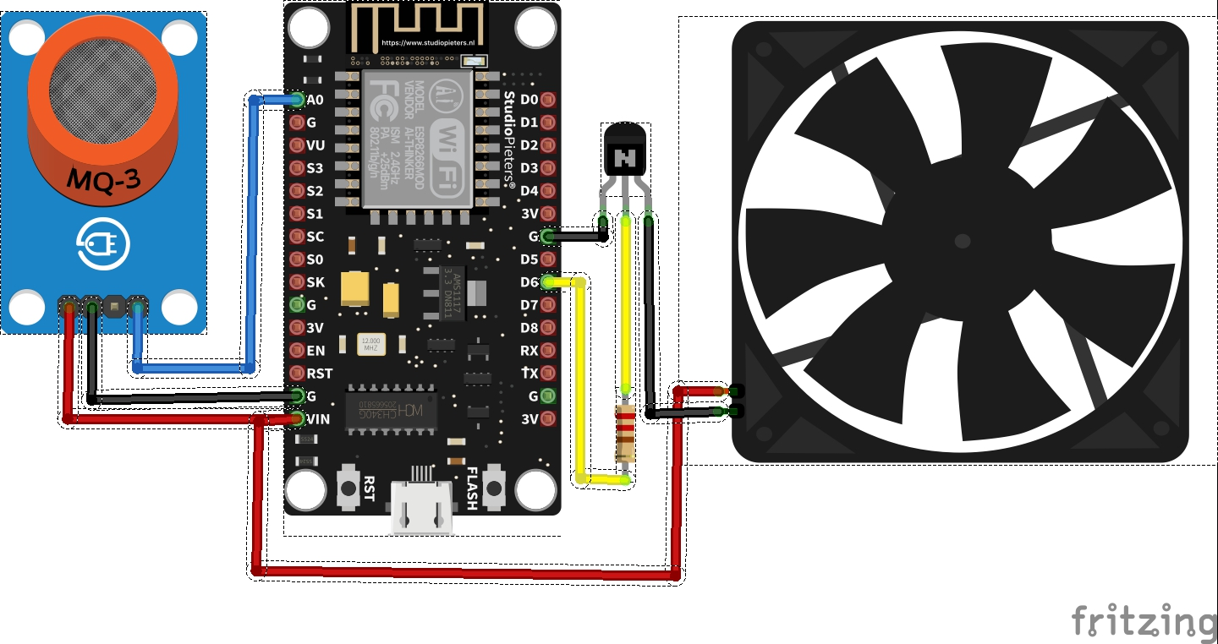
Smoke Detection and Extinction
Connection Diagram
MQ2 | NodeMCU
VCC | Vin / 5V
GND | GND
A0 | A0
Transistor
Emitter | GND
Base | D6
 | Exhaust Fan
5V | Red
Collector | Black

Slide 6
Fire Detection and Alarm System
NodeMCU
BC547 NPN Transistor
1K Resistor
Exhaust Fan
Components Required
IR Flame Sensor
Buzzer

Slide 7
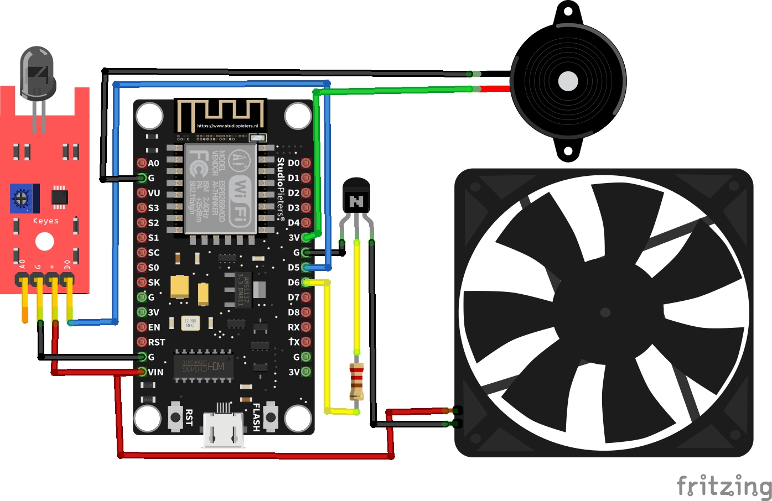
Fire Detection and Alarm System
Connection Diagram
Flame | NodeMCU
VCC | Vin / 5V
GND | GND
D0 | D5
Buzzer
Red | D5
Black | GND
Transistor
Emitter | GND
Base | D6
 | Exhaust Fan
5V | Red
Collector | Black

Slide 8
Temperature and Humidity Monitoring
NodeMCU
BC547 NPN Transistor
1K Resistor
Exhaust Fan
Components Required
Buzzer
DHT11 Sensor

Slide 9
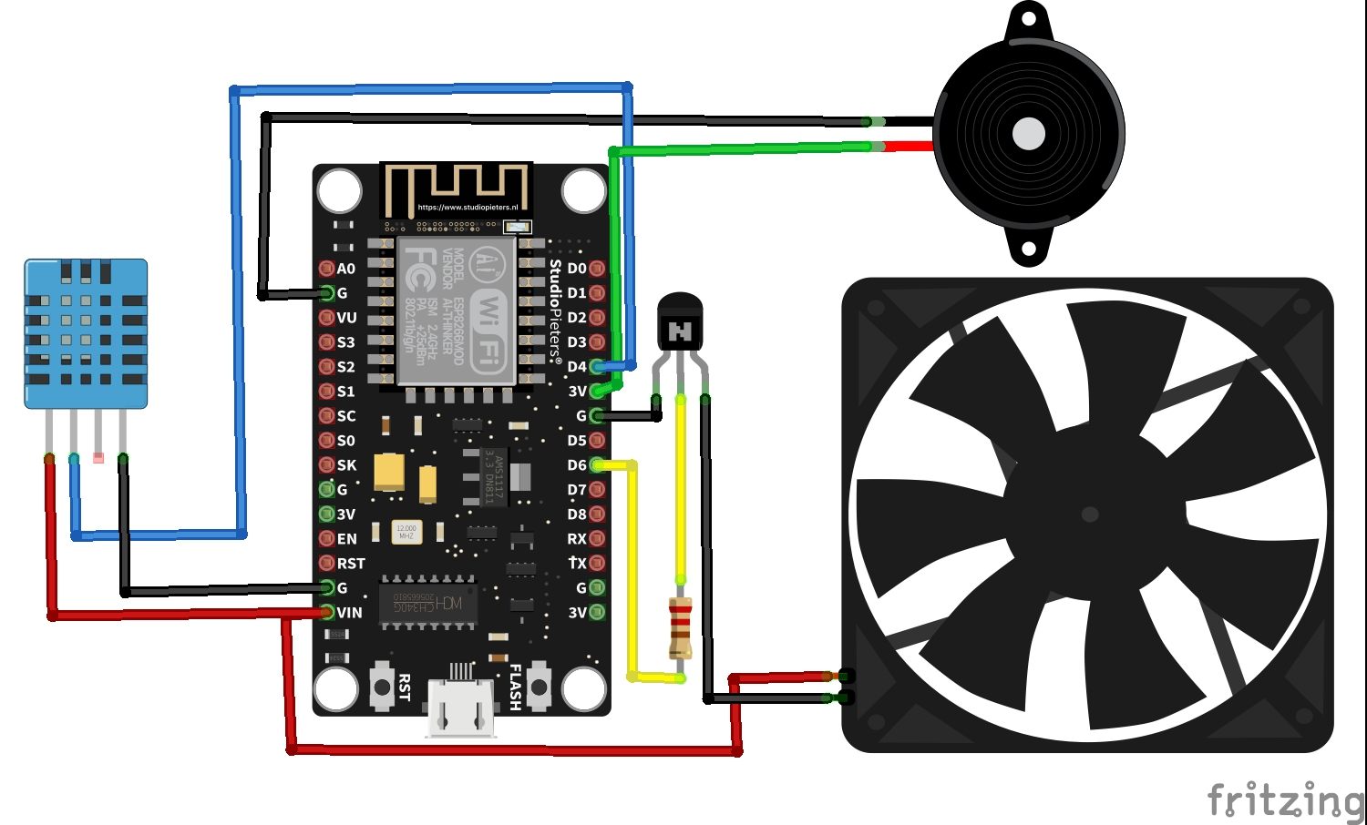
Temperature and Humidity Monitoring
DHT 11 | NodeMCU
VCC | Vin / 5V
GND | GND
Data | D4
Buzzer
Red | D5
Black | GND
Transistor
Emitter | GND
Base | D6
 | Exhaust Fan
5V | Red
Collector | Black

Slide 10
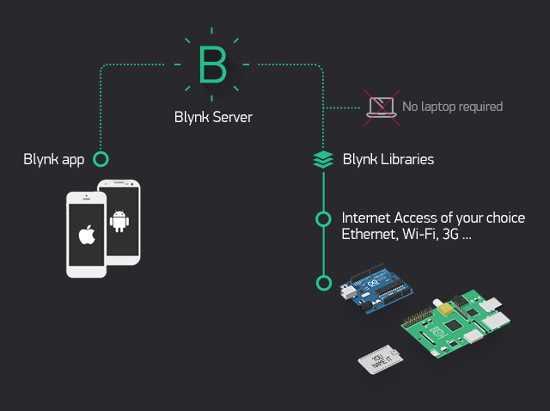
IoT with Blynk Server
Blynk is designed for the Internet of Things. It can control hardware remotely, it can display sensor data, it can store data, and can visualize it.
Blynk App - allows to you create amazing interfaces for your projects using various widgets we provide.
Blynk Server - responsible for all the communications between the smartphone and hardware.
Blynk Libraries - for all the popular hardware platforms - enable communication with the server and process all the incoming and outcoming commands.

Slide 11
FlowChart
Start
MQ2
Flame
DHT11
Send DATA to Server
?
Temp
No
?
Flame
No
?
Smoke
Yes
Yes
Yes
Fan
No
Alerts
No
END

Slide 12
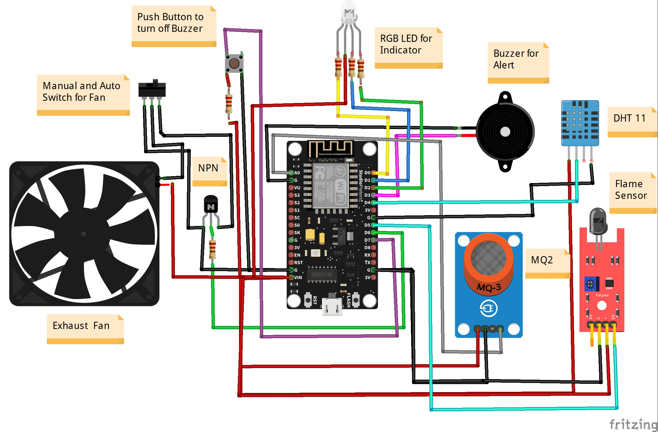
Smart Home System

Slide 13

Thank you

